Slide 1

Introduction to AWS
DATA ANALYTICS BOOTCAMP | IRONHACK

Slide 2


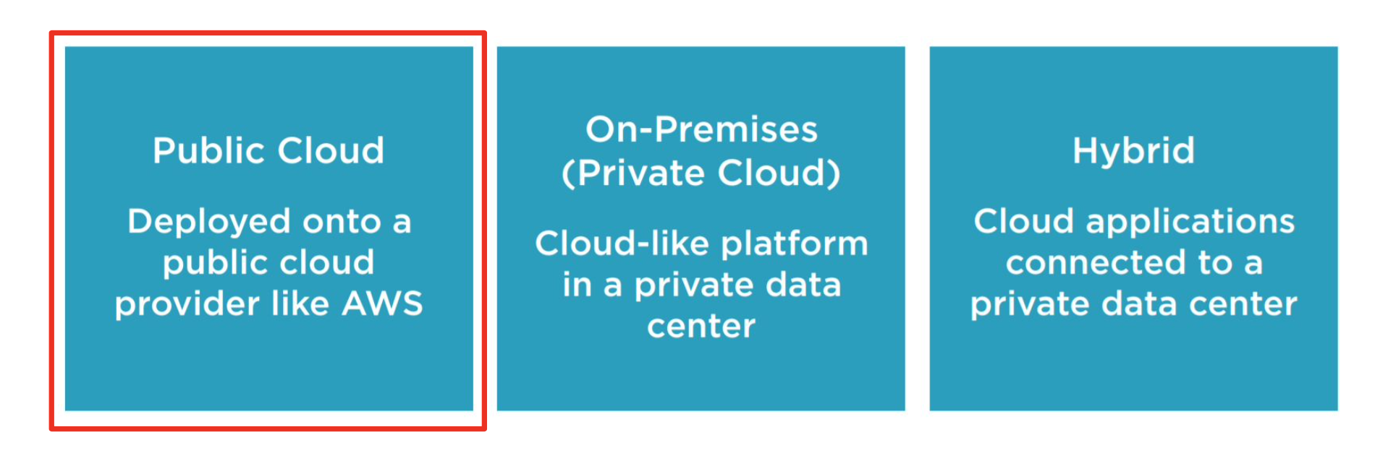
Intro to AWS
Computing models

Slide 3



Intro to AWS
Main cloud computing companies
Each company has their own certification exams

Slide 4
Intro to AWS
AWS provide cloud computing services for anyone on demand.
Not all the companies can afford having a datacenter, pay maintenance, power management, cooling, and upgrades
Ability to acquire resources as you need them and release resources when you no longer need them.
Pay as you go
What, why?

Slide 5
Intro to AWS
Creating an AWS account:
Official documentation

Slide 6
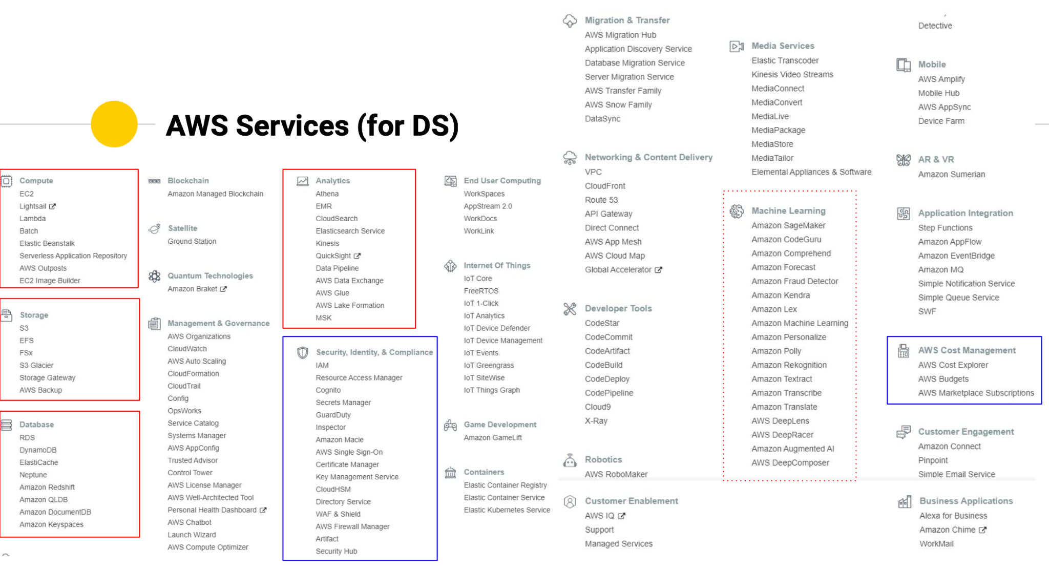
AWS has around 250 different services for different purposes and growing!
Intro to AWS

Slide 7
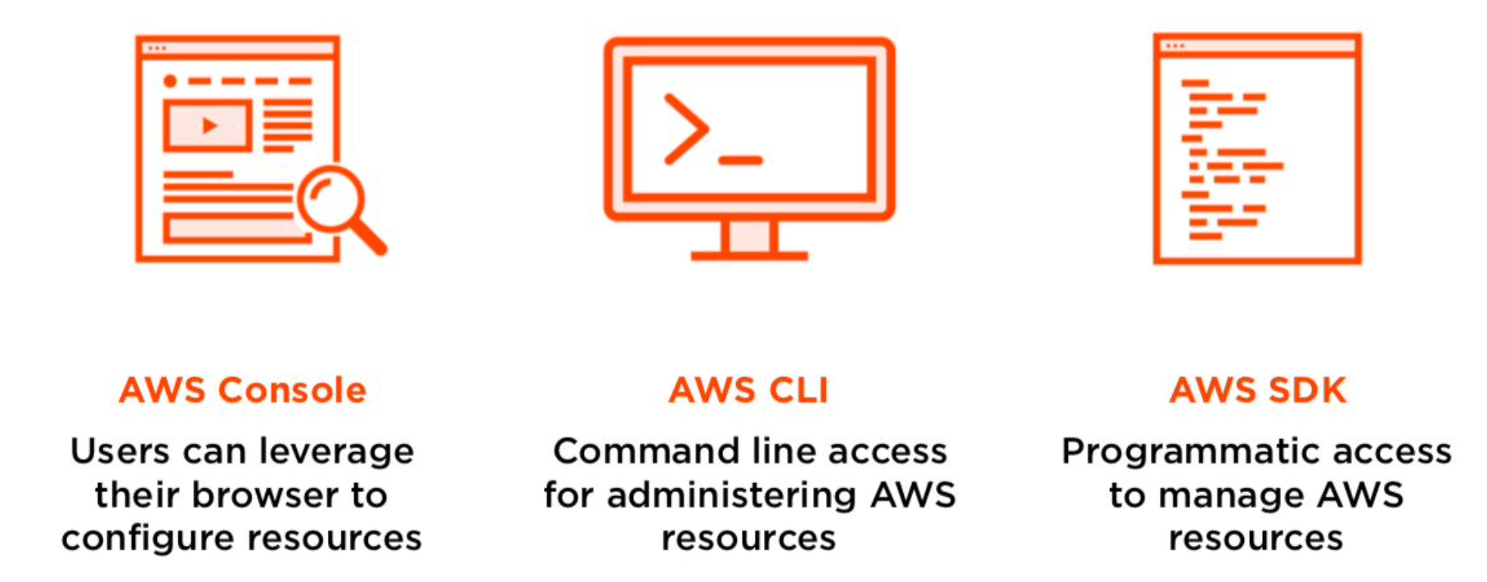
Intro to AWS
Accessing AWS services
Your browser
Installation of AWS CLI
Python library boto3

Slide 8
Intro to AWS
AWS has a world network of data centers full of computers available for rent 24/7 365
Data centers are organized in:
Regions
Availability Zones
How?

Slide 9
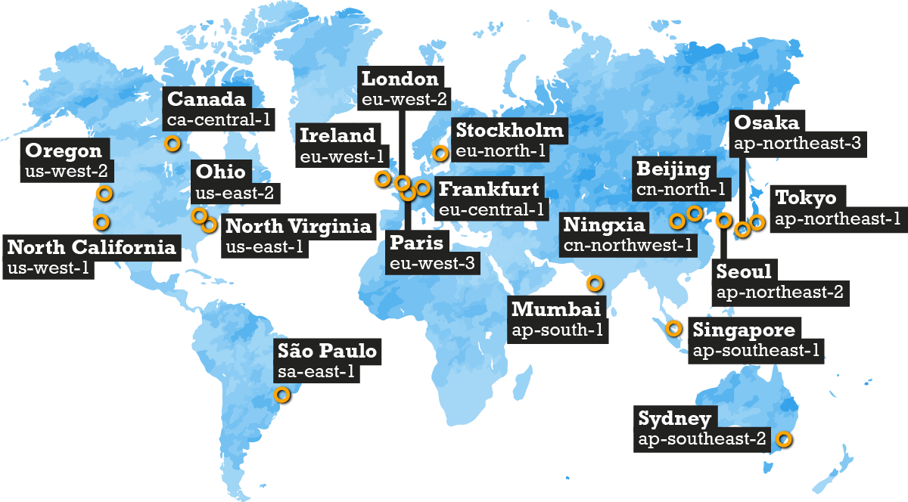
Intro to AWS
Map of AWS regions

Slide 10
Intro to AWS
The root account only has one user and is highly recommended to add additional users for each purpose with their own credentials.
Do not share credentials accounts with anyone!!!
User are enabled at global level: not tied to an specific region.
Users can be grouped in groups
Each user can have different permissions ( called policies )
Default permissions can be granted at group level
Handling users:
IAM

Slide 11
Intro to AWS
IAM Roles
Roles are sets of permissions which can be provided to any AWS service to use another service in your behalf.

Slide 12

Is a very cheap service to store information organized in buckets.
Every bucket is tied to an specific region. It can’t be seen from instances in other regions.
Encryption can be enabled for the files stored
Bucket name should be globally unique.
Data transfer between regions is charged. The user can enable cross region replication.
There are several different types of buckets:
Standard
Infrequent access (IA)
Intelligent tier (IT)
One infrequent access (IA)
Glacier
Glacier Deep Archive
Intro to AWS
Storage service:
S3

Slide 13
Intro to AWS
Storage service:
S3
User can enable:
Permissions
Versioning ( not git, internal )
Lifecycle ( change the type of bucket according to time interval )

Slide 14

In particular, if we want to rent a computer, the service to use is EC2.
EC2 service has many different types of computers called “instances” grouped in families and subfamilies:
Family ( T, C, G,....)
Subfamily. ( T2.micro, T2.medium…)
Instance types official documentation
Every instances comes with it’s own hard drive, but it is ‘volatile’. (disappears when whe machine is terminated)
Intro to AWS
Virtual machine service: EC2

Slide 15
Additional hard drives can be attached to the current instance. ( cheap by payware: EBS service, EFS for shared service across ec2 instances like NFS )
The user can select among several different types of OSs to be installed in every instance:
Freeware
Payware
Third parties
Every instance is launched on an specific REGION.
Every instance has a different price per use.
Intro to AWS
Virtual machine service: EC2

Slide 16
Additional hard drives can be attached to the current instance. ( cheap by payware )
The user can select among several different types of OSs to be installed in every instance:
Freeware
Payware
Third parties
Every instance is launched on an specific REGION.
Every instance has a different price per use/region
Intro to AWS
Virtual machine service: EC2

Slide 17
By default every instance come with a user and credentials.
Additional access is controlled by means of “security groups”.
“Security groups” controls inbound and outbound traffic to the instance.
By default Outbound traffic is allowed.
Inbound traffic is blocked except some services and ports.
“Security groups” can control access at IP level.
Every instance has a public IP and a internal IP
Intro to AWS
EC2 access

Slide 18
Intro to AWS
There are four delivery options that can affect the final price:
On demand: the instance is provided to the customer within seconds. (price per second after 1min)
Spot: bidding service for instance resource ( the user specifies a threshold price to pay and the instance runs whenever the price is lower than the threshold, but it’s terminated when not losing everything)
EC2 costs (I):

Slide 19
Intro to AWS
Reserved instances: instances permanently available for:
1 year
3 years
Standard instances
Convertible instances
Scheduled instances
Payment options:
Upfront
50% upfront, 50% end of service
End of service
Dedicated instances
Dedicated hosts
EC2 costs (II):

Slide 20

This is a self managed service which uses jupyter notebooks to:
Label data
Explore data
Train models
Deploy models in production
It allows to carry out all the previous steps all in one or individually
It has GitHub integration
Integrates with S3 service
It has his own library covering many ML models
It has access to boto3 ( AWS SDK )
Intro to AWS
Sagemaker

Slide 21
What it does and how?
Official documentation
It comes with many libraries already installed and different types of “Kernels” with additional libraries already installed.
To train a model you can use:
Sklearn
Keras
….
Sagemaker library
Sagemaker studio uses particular types of instances for ML (not the regular ones)
It needs to have the data stored into an S3 bucket
It perform hyperparameter optimization on separate “training instances” and returns the output into another S3 bucket
Allow to “deploy” your model into another “inference instance”
Intro to AWS
Sagemaker

Slide 22
Intro to AWS
You will be charged at the end of the month by every payware service used during the month. No use, no charge
The bill summary is updated on a daily basis
Billing

Slide 23
Intro to AWS
Creating an AWS instance from Python
Manage EC2 instances
Transfering files to running ec2 instances
Running command during ec2 instance start
Sagemaker
Additional resources

Slide 24


